Slide 1
Technology and Human Rights: Rise of Cybercrimes in the Philippines
Advanced Dynamic Web Applications Final Requirement
Presented by Advocacy Project Group 5

Slide 2
INTRODUCTION
The Internet has been a common ground for present-day criminals to utilize as a means to mobilize their malicious intentions, otherwise known as cybercrimes. Cybercrimes are illegal activities done using computers or the Internet. Their actors, known as cybercriminals, use different techniques to carry out their crimes, such as phishing, social engineering, and malware as part of their cyber attacks (Latto, 2022).
As technology evolves, so do the cybercrimes that happen on the Internet. Cybercriminals have countless creative ways to attack their victims which is why Internet users have a duty and responsibility to stay informed and aware of such crimes to prevent their emergence.

Slide 3
PROBLEMS/ISSUES
To reinstate, cybercrimes are still a lingering problem in the Philippines at present. Years have passed since the Cybercrime Prevention Act and the Anti-Bullying Act (which covers cyberbullying) were enacted but the problem stays just the same. According to Statista (2021), Region 3 or Central Luzon took the highest number of victims of fraudulent SMS or text scams in 2019, that amounts to approximately 3.4 million individuals. Other cybercrimes noted on the list involved hacking, phishing, and cyberbullying. A report from CNN in 2020 showed that 37% of the top cybercrimes in 2020 were related to online scams. Online libel and cyberbullying were also among the top cybercrimes in the year 2020 and out of 5 cybercrimes that happened, 3 of which are related to cyberbullying (Sonnie, 2022).

Slide 4
OBJECTIVES
The project aims to address the issues on the emergence of the different cybercrimes and instill awareness to the users on how to be vigilant and prevent becoming a victim of such. It will contain necessary information about the root causes and adverse effects of such crimes and the ways on how people should act as a responsible netizen and how to take care of their online profile/identities. The project also focuses on the development of essential skills using Angular that future web developers like us should possess to advance in our chosen careers.

Slide 5
MOCKUP DESIGN INTERFACE
Draft of the design for the web application

Slide 6
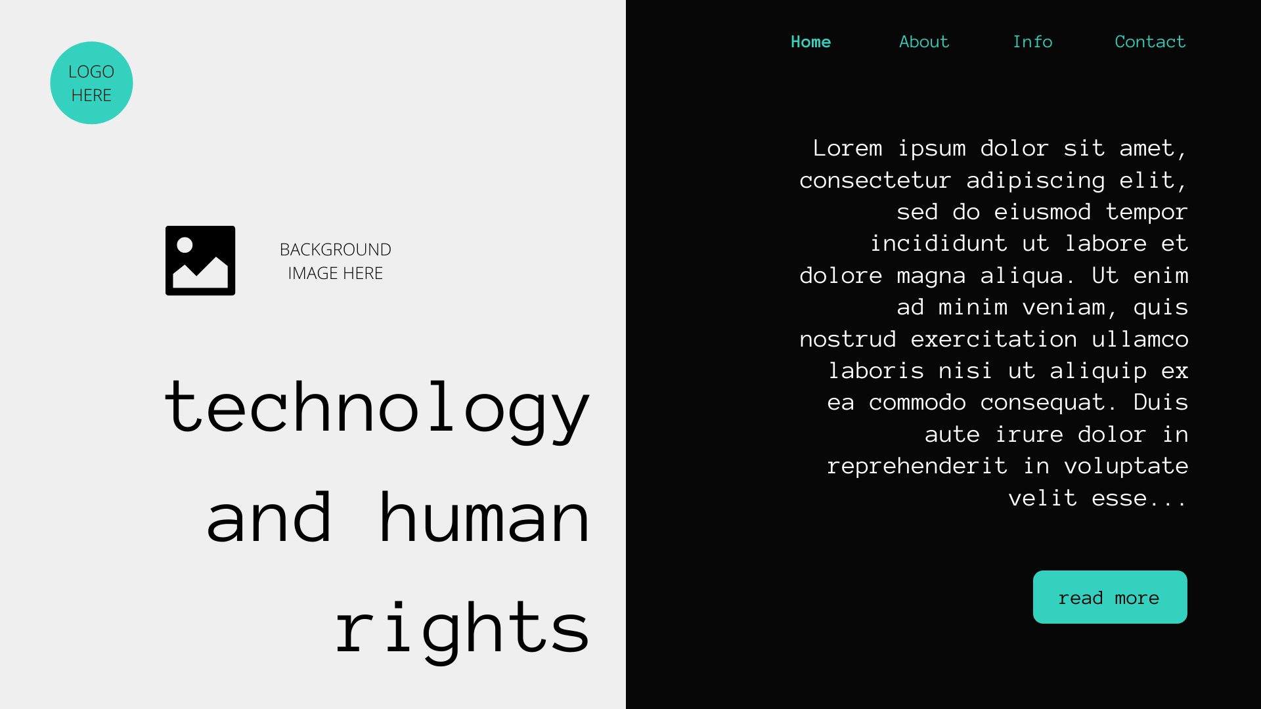

Slide 7
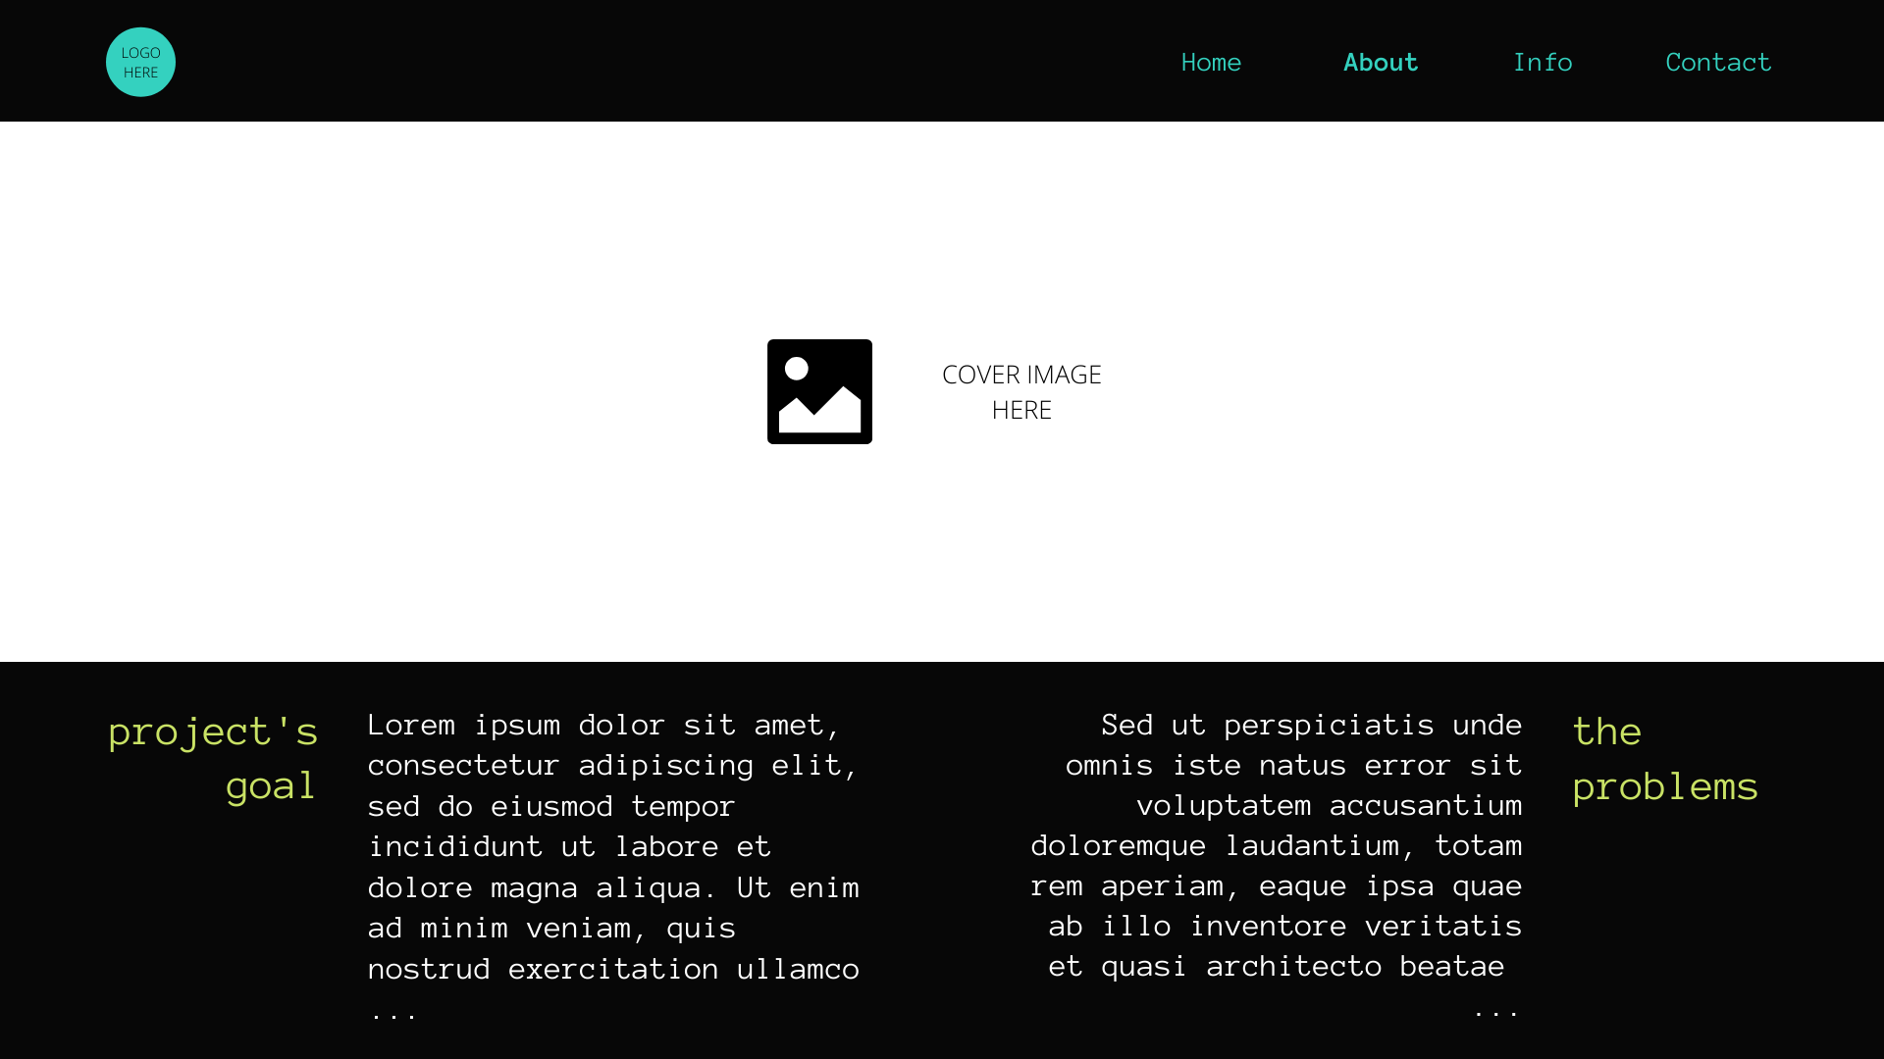

Slide 8
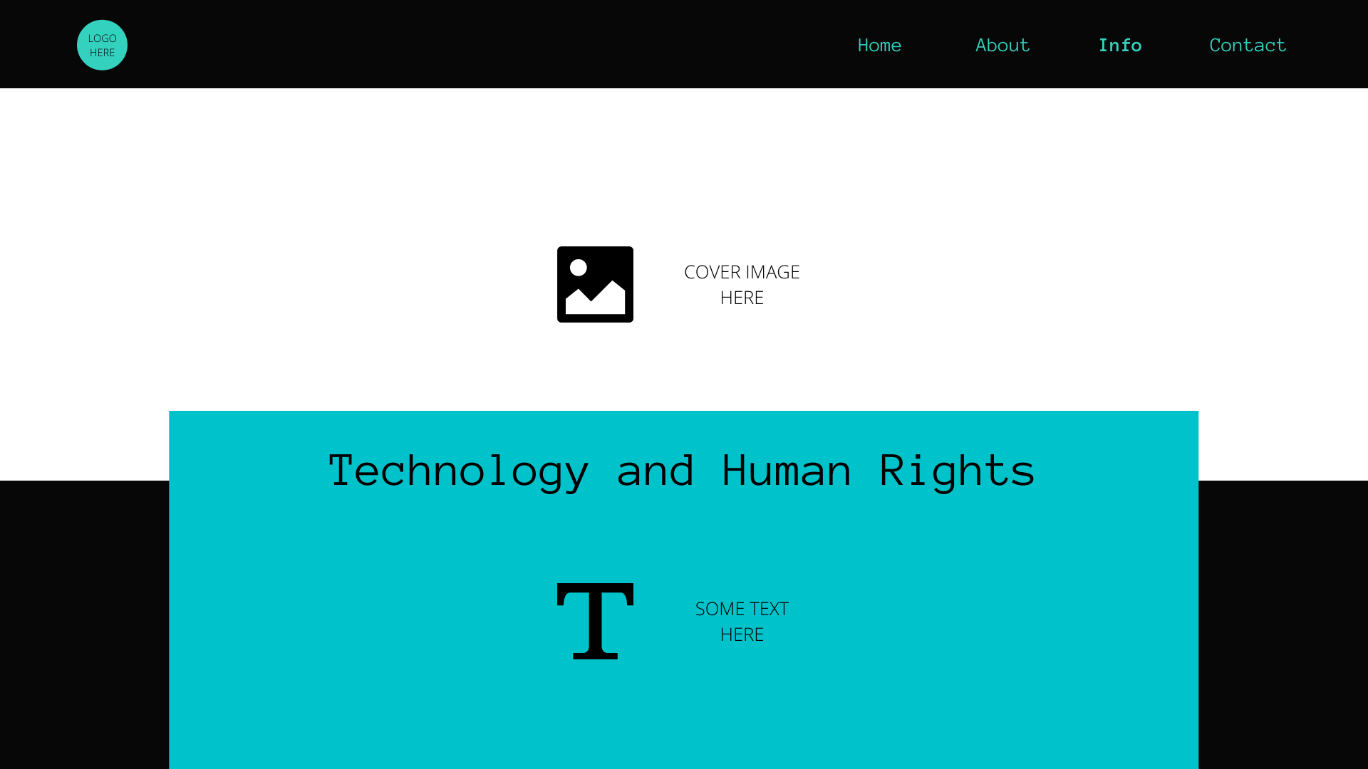

Slide 9
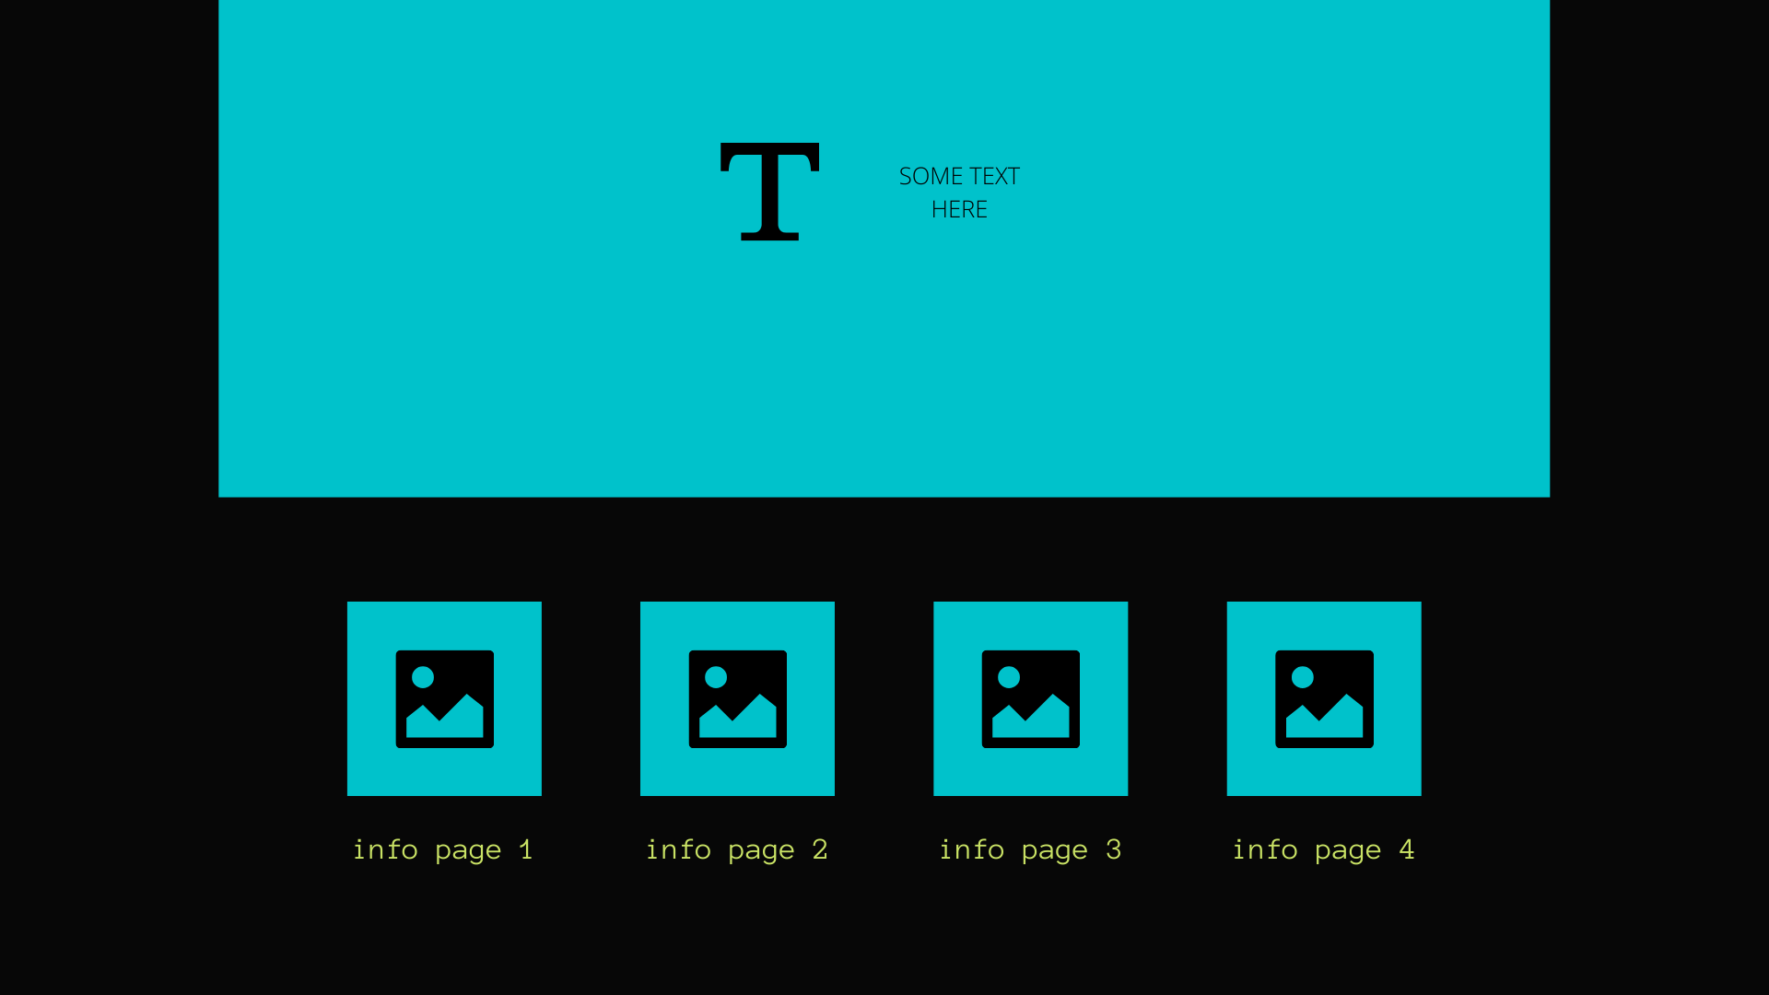

Slide 10
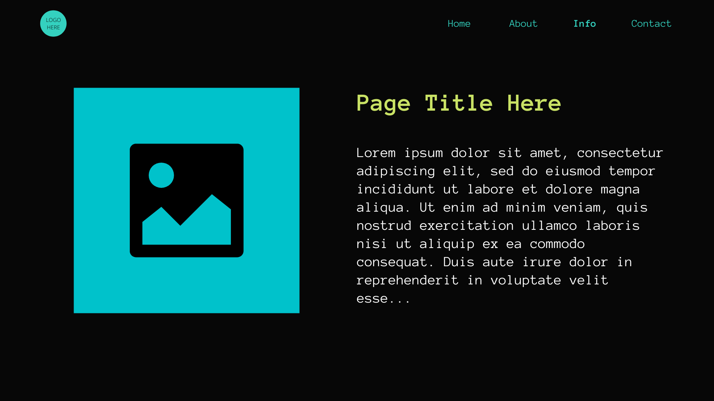

Slide 11
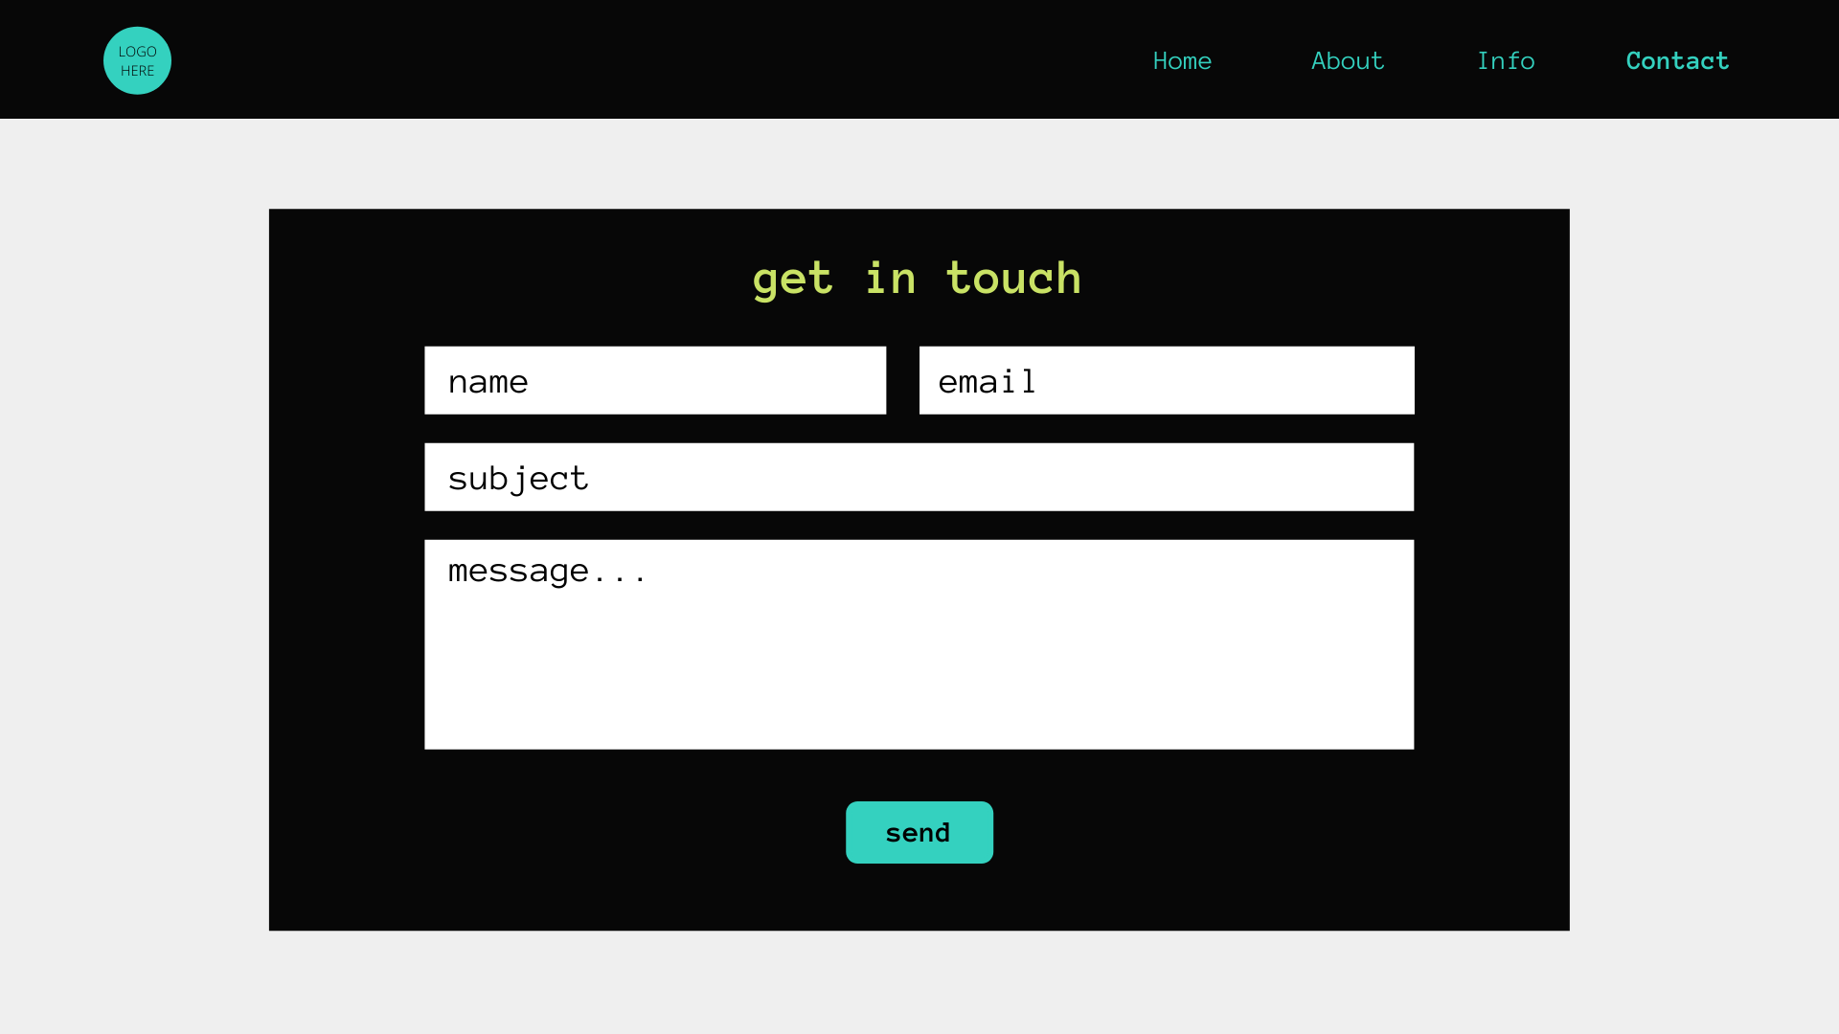

Slide 12
FINAL WEB APPLICATION DEMONSTRATION

Slide 13
GROUP MEMBERS
Cuyagbo, Myra P.
Galura, Jarell Carlo D.
Jardiels, Hans Benedict V.
Mandani, Deidrey Simon Paul L.
Rosos, Almond L.

